Slide 1

Hybrid Quantum-Classical Computing Architectures
The 3rd International Workshop on Post-Moore Era Supercomputing
November 11, 2018
drhgfdjhngngfmhgmghmghjmghfmf
Martin Suchara
Yuri Alexeev*, Frederic Chong†, Hal Finkel*, Henry Hoffmann†, Jeffrey Larson*, James Osborn*, Graeme Smith§
Argonne National Laboratory
msuchara@anl.gov
* Argonne National Laboratory
† University of Chicago
§ University of Colorado – Boulder

Slide 2
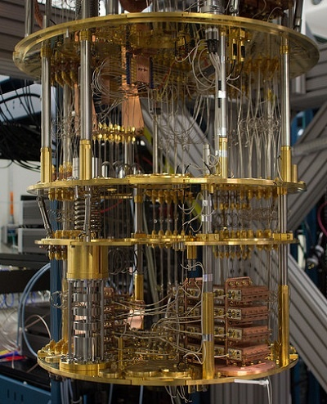
Building Quantum Computers is Really Hard!
We have witnessed remarkable technological advances in qubit manufacturing in the past few years but:
  The cost to build quantum processors is extremely high
  It is difficult to add qubits
  Qubit coherence qubits are steadily improving but will always be a fundamental challenge
IBM Q superconducting quantum computer
How can we use unreliable quantum processors of intermediate size to reliably solve large computational problems?

Slide 3
What We Want – Use Small Quantum Processors to Solve Large Problems

Slide 4
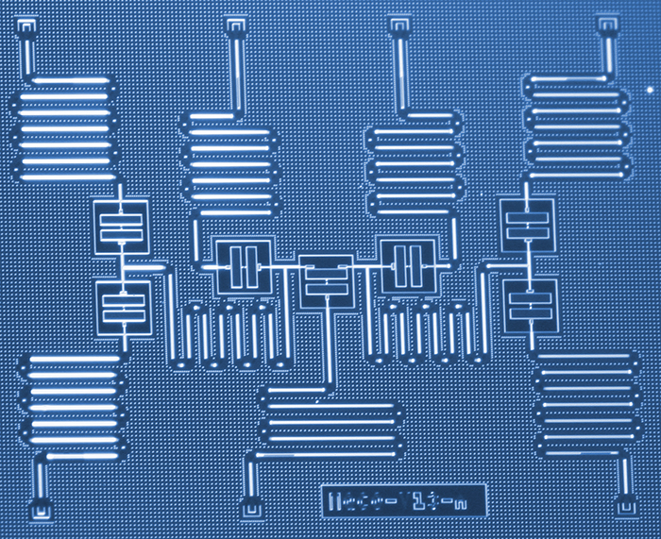
Alternative 1: Cut a Large Quantum Circuit Into Multiple sub-Circuits
Original quantum circuit:
Evaluate this circuit on a device with 7 qubits?
|0⟩
S
Z
|0⟩
T
Z
|0⟩
X
Z
|0⟩
X
Z
|0⟩
Z
|0⟩
S
Z
|0⟩
H
Z
|0⟩
H
Z

Slide 5
Alternative 1: Cut a Large Quantum Circuit Into Multiple sub-Circuits
Processor A
Evaluate this circuit on a device with 7 qubits?
Cost scales exponentially with number of wire and gate cuts
Need to find a clean cut
|0⟩
S
Z
|0⟩
T
Z
|0⟩
X
Z
|0⟩
X
Z
|0⟩
Z
|0⟩
S
Z
|0⟩
H
Z
|0⟩
H
Z
Processor B
Bravyi, Smith, Smolin, Phys. Rev. X, 2016
Harrow, Ozols et al., Semantic Scholar and private communication

Slide 6
Alternative 1: Cut a Large Quantum Circuit Into Multiple sub-Circuits
Original circuit
|0⟩
X
Z
|0⟩
Z

Slide 7
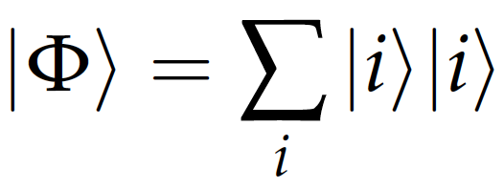
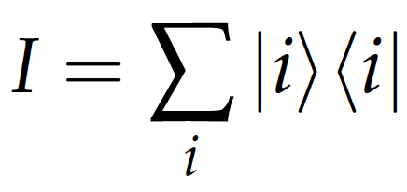
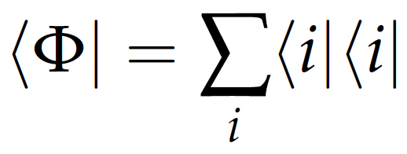
Alternative 1: Cut a Large Quantum Circuit Into Multiple sub-Circuits
Original circuit
|0⟩
X
Z
|0⟩
Z
|00⟩+ |11⟩

Slide 8
Alternative 1: Cut a Large Quantum Circuit Into Multiple sub-Circuits
Original circuit
|0⟩
X
Z
|0⟩
Z
|00⟩+ |11⟩
Fragment B
|0⟩
H
Z
Fragment A
|0⟩
X,Y,Z
|0⟩
X
X,Y,Z
|0⟩
Z

Slide 9
Combining the Outputs with Classical Postprocessing
Repeatedly run each circuit, perform measurements in the X, Y and Z bases, and record the measurement outcomes
Fragment B
Fragment A
Z
|0⟩
H
|0⟩
X
X,Y,Z
|0⟩
X,Y,Z
|0⟩
Z
The probabilities you expect:
X
Y
Z
X
Y
Z
Outcome
0 0 0 | 0.25 | 0.25 | 0.5
0 1 0 | 0.25 | 0.25 | 0
1 0 1 | 0.25 | 0.25 | 0
1 1 1 | 0.25 | 0.25 | 0.5
Outcome
0 | 0.5 | 0.5 | 0
1 | 0.5 | 0.5 | 1

Slide 10
Combining the Outputs with Classical Postprocessing
Repeatedly run each circuit, perform measurements in the X, Y and Z bases, and record the measurement outcomes
Fragment B
Fragment A
Z
|0⟩
H
|0⟩
X
X,Y,Z
|0⟩
X,Y,Z
|0⟩
Z
Results with a quantum simulator:
X
Y
Z
X
Y
Z
Outcome
0 0 0 | 0.25 | 0.27 | 0.5
0 1 0 | 0.26 | 0.25 | 0
1 0 1 | 0.24 | 0.25 | 0
1 1 1 | 0.25 | 0.23 | 0.5
Outcome
0 | 0.49 | 0.49 | 0
1 | 0.51 | 0.51 | 1

Slide 11
Combining the Outputs with Classical Postprocessing
Repeatedly run each circuit, perform measurements in the X, Y and Z bases, and record the measurement outcomes
Fragment B
Fragment A
Z
|0⟩
H
|0⟩
X
X,Y,Z
|0⟩
X,Y,Z
|0⟩
Z
Results on a 16-qubit IBM Q processor:
X
Y
Z
X
Y
Z
Outcome
0 0 0 | 0.30 | 0.30 | 0.37
0 1 0 | 0.19 | 0.20 | 0.05
1 0 1 | 0.16 | 0.17 | 0.10
1 1 1 | 0.20 | 0.20 | 0.27
Outcome
0 | 0.52 | 0.56 | 0.05
1 | 0.48 | 0.44 | 0.95

Slide 12
Combining the Outputs with Classical Postprocessing
Finally we combine the results using multiplicative factors from Harrow et al.:
X
Y
Z
X
Y
Z
Outcome
0 0 0 | 0.25 | 0.25 | 0.5
0 1 0 | 0.25 | 0.25 | 0
1 0 1 | 0.25 | 0.25 | 0
1 1 1 | 0.25 | 0.25 | 0.5
Outcome
0 | 0.5 | 0.5 | 0
1 | 0.5 | 0.5 | 1
*1 if same, *-1 if different
Outcome | Estimate
0 0 | 0
0 1 | 0
1 0 | 0
1 1 | 1
*-1 if same, *1 if different
*2 if same, *0 if different
|0⟩
X
Z
Output:
|11⟩
|0⟩
Z

Slide 13
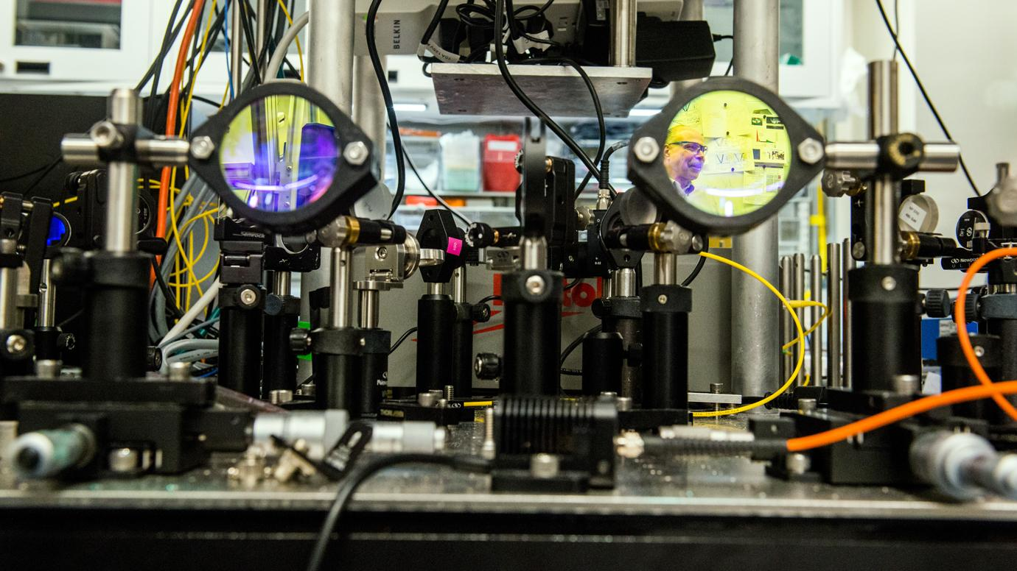
Alternative 2: Teleport some Qubits Between Quantum Processors
Quantum teleportation circuit:
|𝜓⟩
H
Z
|0⟩
H
Z
|0⟩
X
Z
|𝜓⟩
Quantum teleportation allows to transmit quantum state between two network hosts
Requires distribution of entangled particles followed by classical communication
Experimental demonstrations
30-mile teleportation network under construction at Argonne
Optical table demonstrating the principles of quantum teleportation in the Awschalom Lab (University of Chicago and Argonne)

Slide 14
Alternative 2: Teleport some Qubits Between Quantum Processors
Processor A
|0⟩
Z
Processor B
|0⟩
X
Z

Slide 15
Alternative 2: Teleport some Qubits Between Quantum Processors
Processor A
|0⟩
Z
X
Z
Z
Z
Processor B
|0⟩
X
H
Z
X
Z
Z
Z
Additional gates introduce errors
Introduces communication latency
Avoids the need to repeatedly evaluate sub-circuits
Entanglement generator
|0⟩
H
|00⟩+ |11⟩
|0⟩

Slide 16
Summary and Future Work
Uses small quantum processors to evaluate large circuits
Can be done now
Circuits must be cleanly separable
Exponential cost depends on number of gate cuts
New potential application for quantum teleportation networks
Teleportation will be imperfect and will introduce latency
Linear scaling of overhead
Which quantum algorithms are suitable for these techniques, and which should be simulated classically?

Slide 17
Thank You!
Postdoctoral And Summer Student Positions Available
Requisition number 405345 on www.anl.gov
For inquiries send email to msuchara@anl.gov
Acknowledgements: This material is based upon work supported by the U.S. Department of Energy, Office of Science, under contract number DE-AC02-06CH11357. The work is also funded in part by EPiQC, an NSF Expedition in Computing under grant CCF-1730449, by NSF PHY-1818914, and by a research gift from Intel.

